Slide 1
Galaxy Classification Using Deep Learning
- Evan Chow, Dvir Zagury, Pierson Tomietto, Patrick Thompson, Toumai Rouse

Slide 2
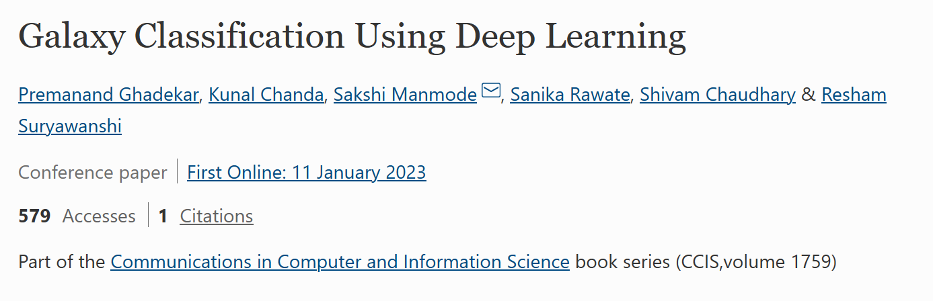
The Paper
Proposes a way of classifying galaxies in scale via ML

Slide 3
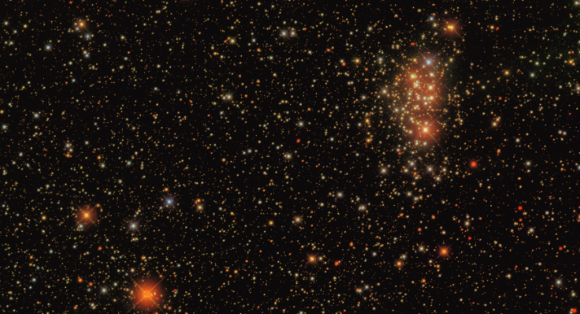
Problem Statement
Sky Surveys:
Hundreds of thousands of galaxies.
Manually classified by votes.
Wasted time and resources
From Sloan Digital Sky Survey (SDSS)

Slide 4
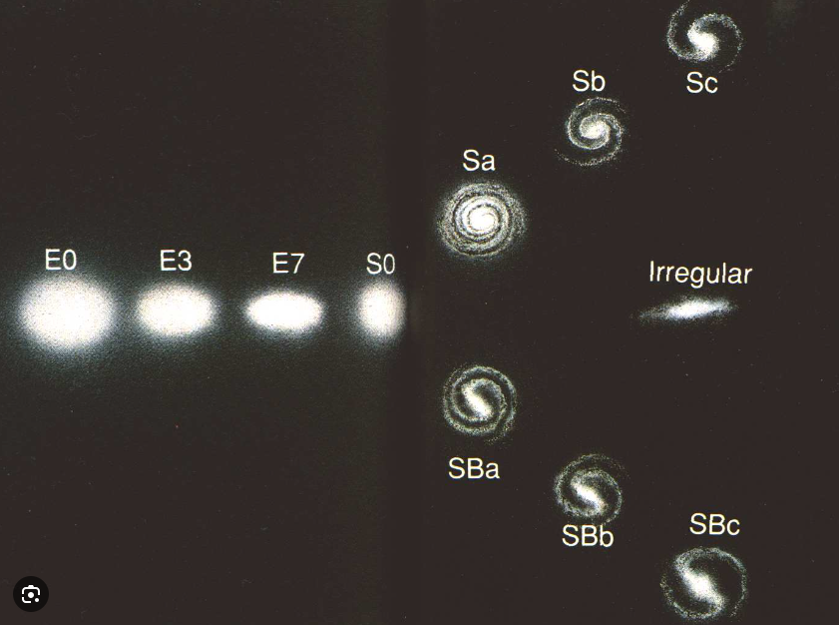
Background
Galaxy Classification:
Elliptical
Spiral
Irregular
Based on Visible Attributes:
Spiral arms
Tightness of spiral
Eccenticity
Symmetry
Center bars
Bulge
Hubble Tuning Fork

Slide 5
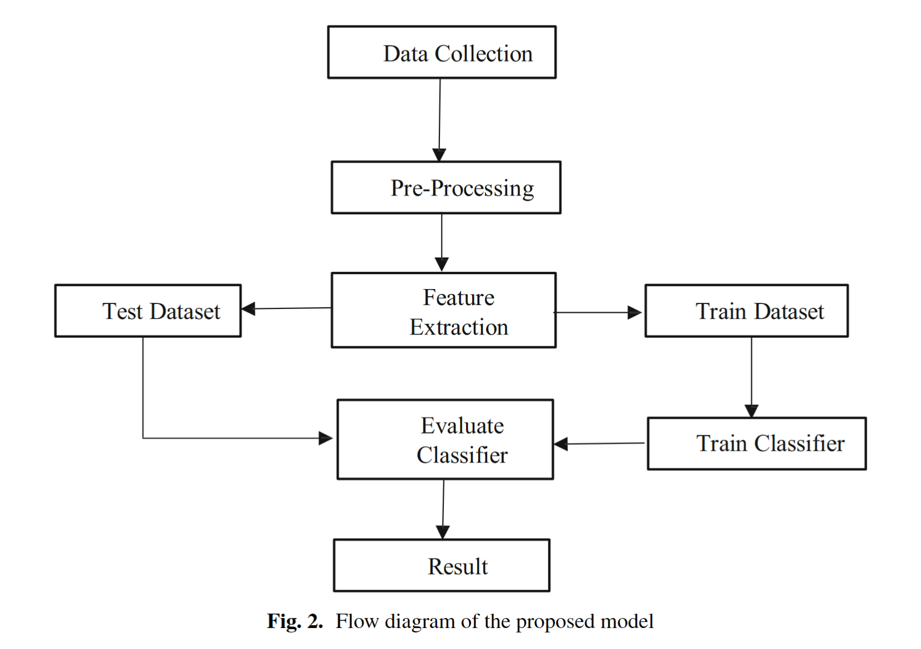
Overview

Slide 6
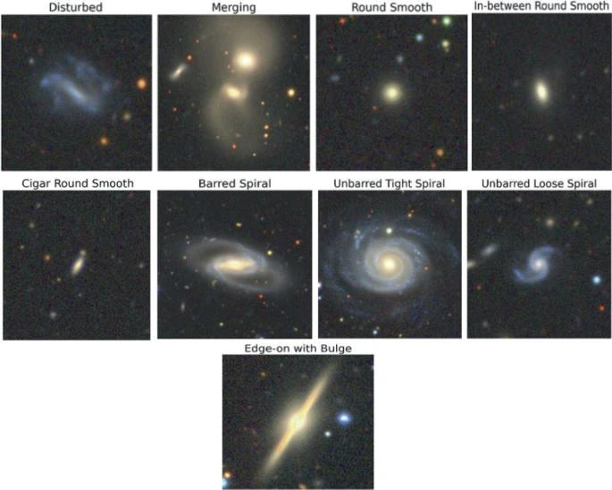
Data Collection and Pre-Processing
Galaxy10 DECals Dataset
~18,000 galaxies
10 Classifications
256x256 pixel colour images
Input Layer includes 16 filters

Slide 7
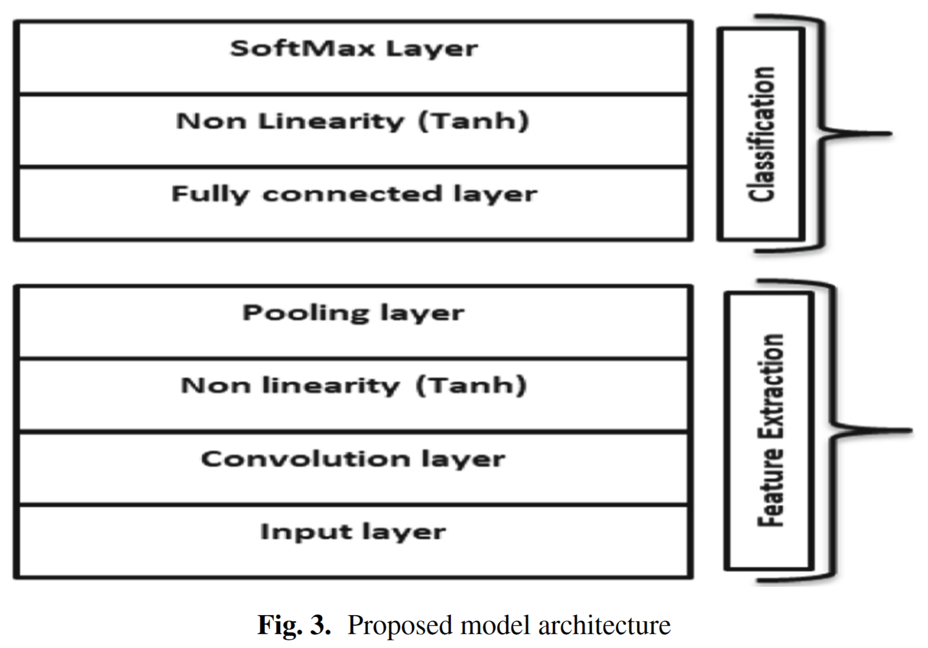
Model Architecture
CNN with one input layer after 16 filters pre-processing. Followed by 4 hidden layers. 1 fully connected layer. Final output Softmax layer.

Slide 8
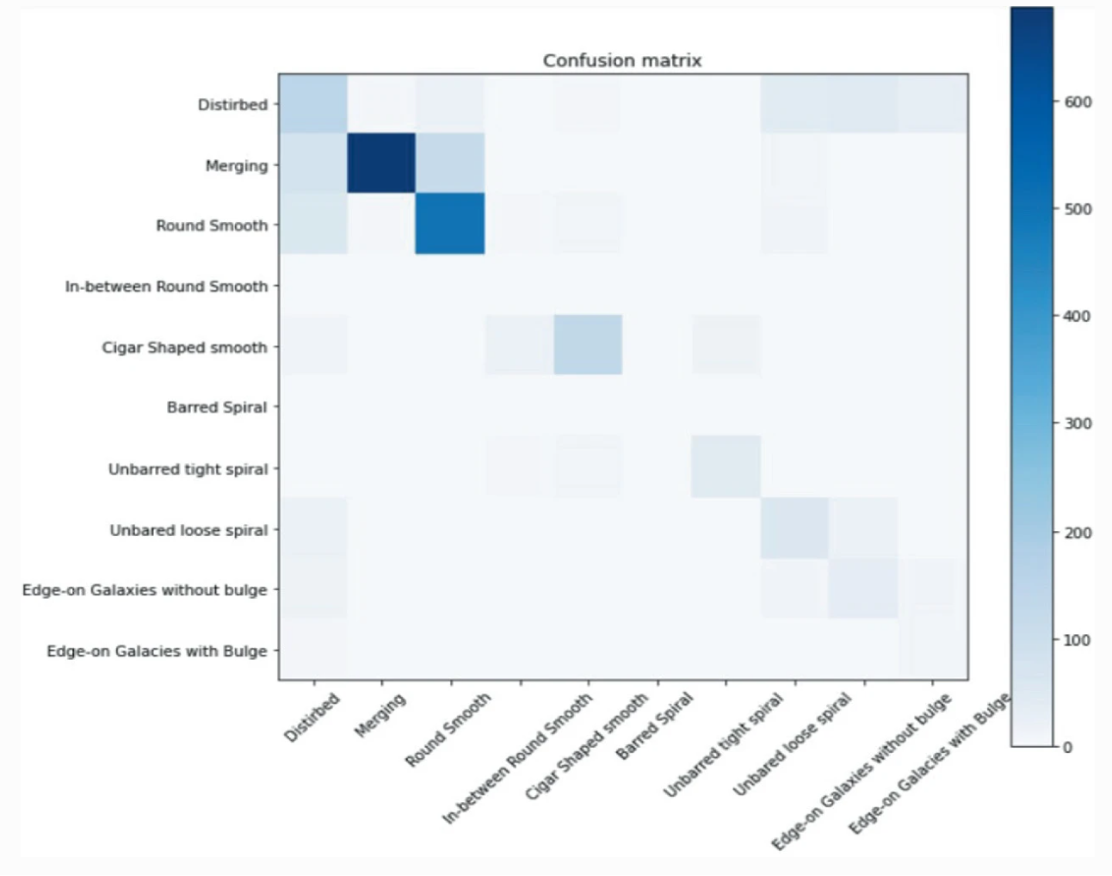
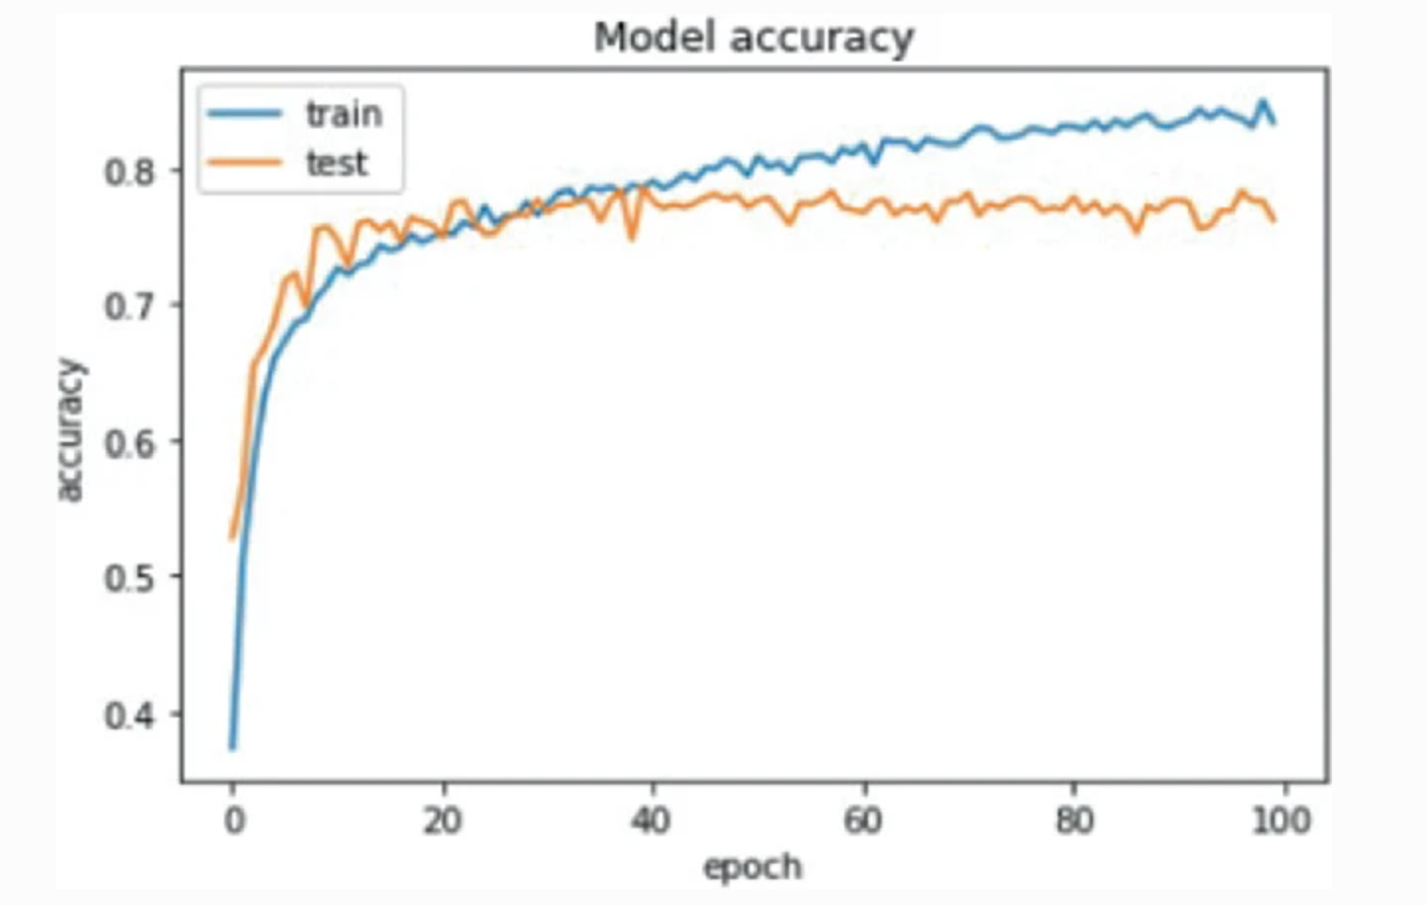
Results
~30
Notes:
Confusion Matrix: along diagonal Darker gradient color corresponds to the models accuracy in predicting the classifier( higher model accuracy for merging, distributed and round smooth), off diagonal squares indicates which classifies the model returned incorrect predicts and what it predicted them to be.
Model accuracy: right figure shows the total accuracy of the model on both the training data(blue line) and the test data (orange line), can see the start of a significant plateau at around 30 epochs, which is something we can keep in my mind during own project.

Slide 9
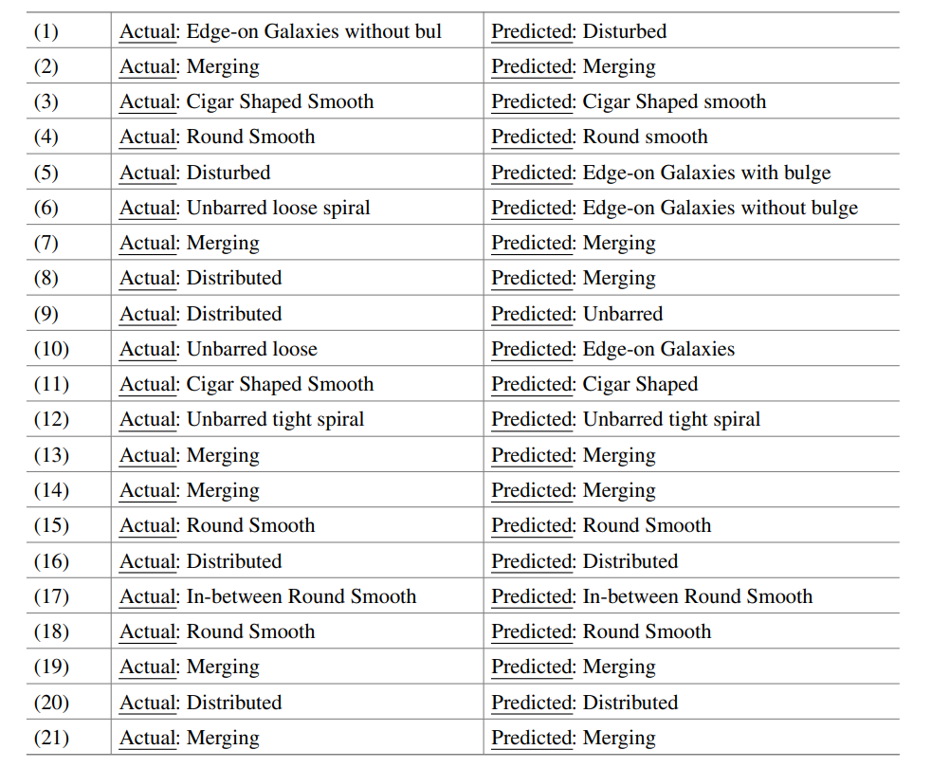
Section of the final results
Figures show the input image of a galaxy and the respective output, the model predicted:
Notes:
Tabulated version of the results, can see how It agrees with confusion matrix in terms returning predicting all the merging galaxies.

Slide 10
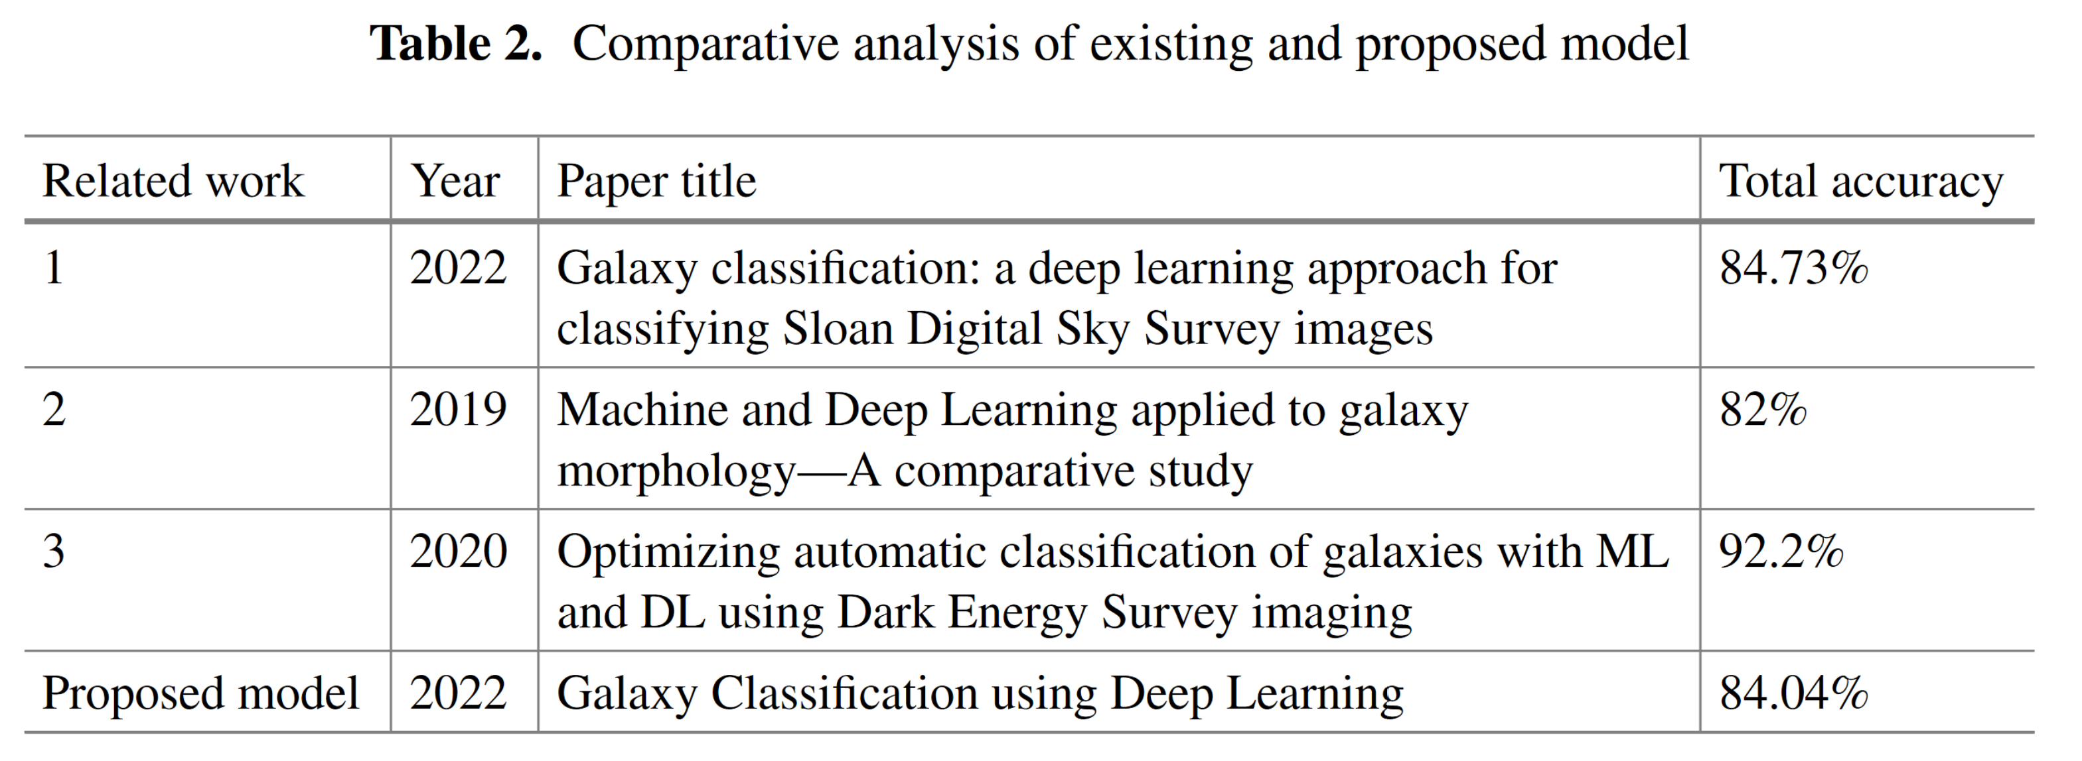
Comparison
Notes:
2020 paper: with 92.2% used a better model( restricted Boltzmann machine ) and the DESI year one gold dataset.
The next step for this paper is training using a greater size dataset with higher quality images as well implementing more advanced machine learning techniques.

Slide 11
Roadmap
Training dataset is available
Using laptop with dedicated GPU for training
Number of epochs needed is inferred from Toumai’s graph
Recreate the comparison table in the paper

Slide 12
Timeframe
1st Week | 2nd Week | 3rd Week | 4th Week | 5th Week
Gathering and preprocessing of training data Develop code for model | Training and back-propagation | Training and back-propagation | Testing | Generating reports Presentation

